Slide 1
Responsible AI Course: Emerging Trends in IT Advisor: Brad Olsen Date: 10/28/2025

Slide 2
Purpose
To influence people's to be more mindful when using AI

Slide 3
Project Statement
Project showcases evidence of the environmental consequences of AI, and solutions.

Slide 4
Reasoning
Large data centers can consume up to 5 million gallons per day. ("Yañez-Barnuevo", 2025)
With larger and new AI-focused data centers, water consumption is increasing alongside energy usage and carbon emissions. ("Yañez-Barnuevo", 2025)
By 2030, data centers could account for as much as 11% of U.S. power demand — up from 3% ("LA Times" 2024)

Slide 5

How Does AI Impact the environment?
Energy Consumption
Water Consumption
Co2 Emissions

Slide 6
How Does AI Impact the environment?
Because of the computational power required to run these models at the speed seen through modern online chat bots, these models are ran on extremely powerful computers all held together in data centers owned for or paid for by the company. More computational power does not necessarily mean better energy efficiency to produce that power, and often times these powerful computers release large amounts of heat far greater then personal computers, with all of these computers in one single space powerful cooling is needed to keep the computers from overheating. For this reason liquid cooling is used often derived from fresh water sources that run through tubes alongside the machine dissipating the heat from the machines to the water which over time declines as it evaporates through special ducts.

Slide 7

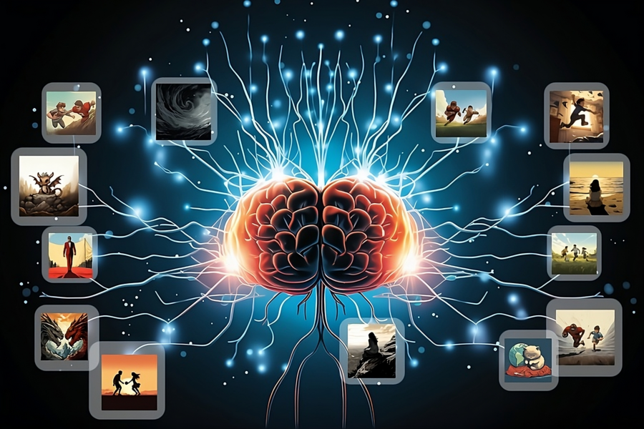
Energy Consumption
AI processes require more energy
AI processors (GPU’s) are much more complex
Require more memory storage
Training AI Models puts a massive load on these processors

Slide 8
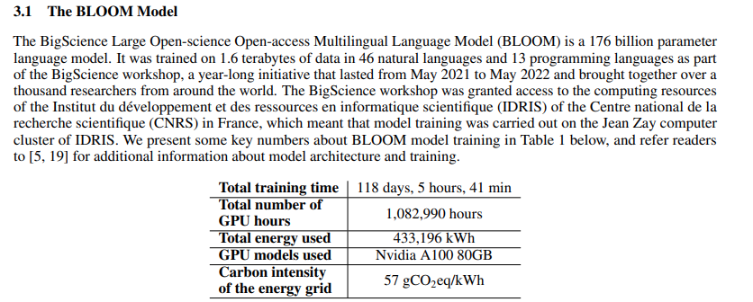
Energy Consumption
AI processes require more energy

Slide 9
Energy Consumption
AI processes require more energy
2018, combined U.S. data center consumption estimated to be 76 TWh, 1.9% of total U.S. energy consumption (Berkeley)
2023, combined U.S. data center consumption estimated to be 176 TWh, 4.4% of total U.S. energy consumption (Berkeley)
Efficiency is not growing at the same rate as demand (Berkeley).
July 2025, ChatGPT receives an average of 18 billion messages a week, 2.57 billion a day (OpenAI)
The median Gemini prompt wastes 6 times more than a traditional google search.
Gemini Prompt is 0.24 Wh (googleblog), Google search is 0.04 Wh (Wim),
Video Generation consumes roughly 2,000 time more energy than text generation (Luccioni et al.)
Notes:
“During the early and mid-2010s, a shift from on-premise data centers to colocation or cloud facilities helped enable efficiency improvements that allowed data center electricity use to remain nearly constant at a time when the data center industry grew significantly, with a large expansion of data center services.” (Berkeley)
In a study where the average cost of text generation was 0.047 Wh, the average cost of a single short video was nearly 90 Wh making it 1,915 times more costly

Slide 10
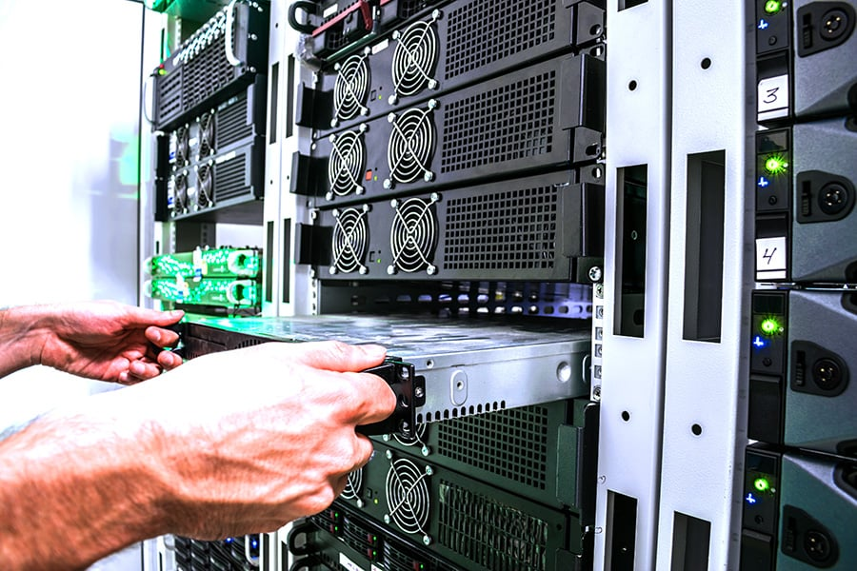
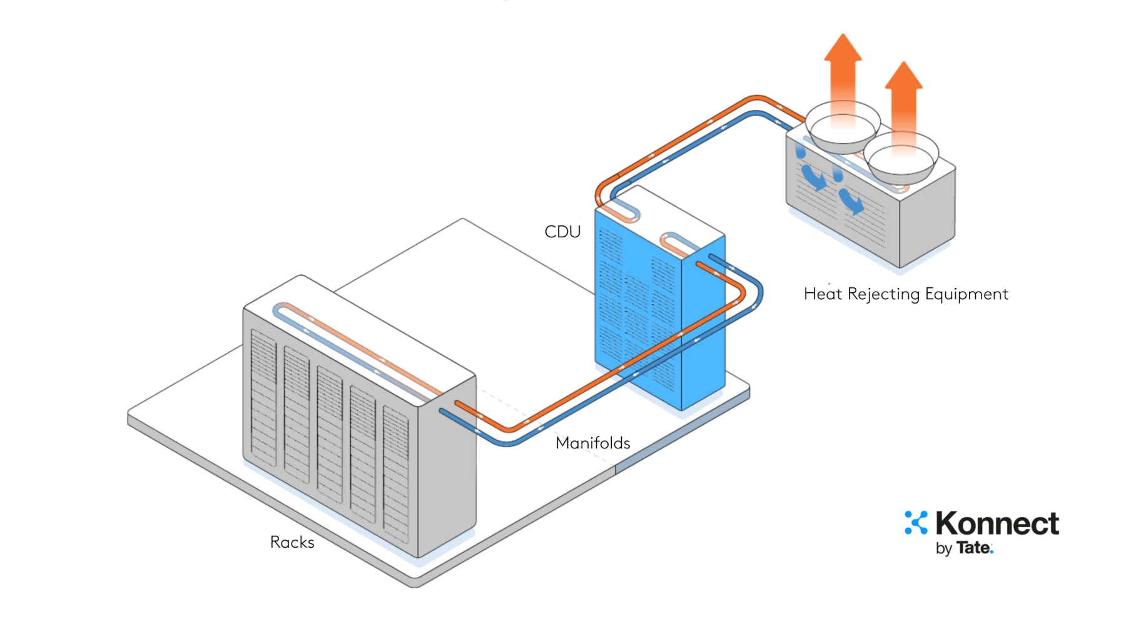
Water Consumption
Data centers consume water for cooling
Packed super computers create lots of heat
Water tubes touch the computers
Heat transfers from computer to tube water
Water is cooled back down evaporating in the process

Slide 11
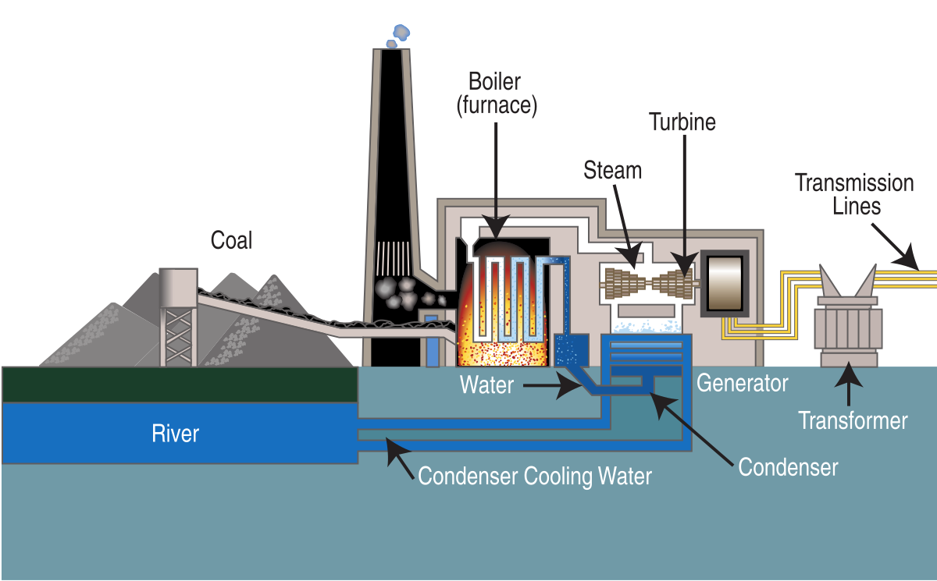
Water Consumption
Power plants consume water to provide electricity
Water comes from fresh water sources
Water is evaporated into steam
Steam makes turbines spin
Turbine motion is turned into electricity sent to data center.

Slide 12
Water Consumption
2014, U.S. data centers consumed 21 billion liters of water (Berkeley)
2023, U.S. data centers consumed 66 billion liters of water (Berkeley)
2023, total indirect water footprint (power plants) 800 billion liters of water
Water consumption from powerplants is a much bigger culprit than water consumption for cooling
https://youtu.be/0YlB5-j1wD0?si=UyM938YdFZnkkcQS
Notes:
“During the early and mid-2010s, a shift from on-premise data centers to colocation or cloud facilities helped enable efficiency improvements that allowed data center electricity use to remain nearly constant at a time when the data center industry grew significantly, with a large expansion of data center services.” (Berkeley)

Slide 13
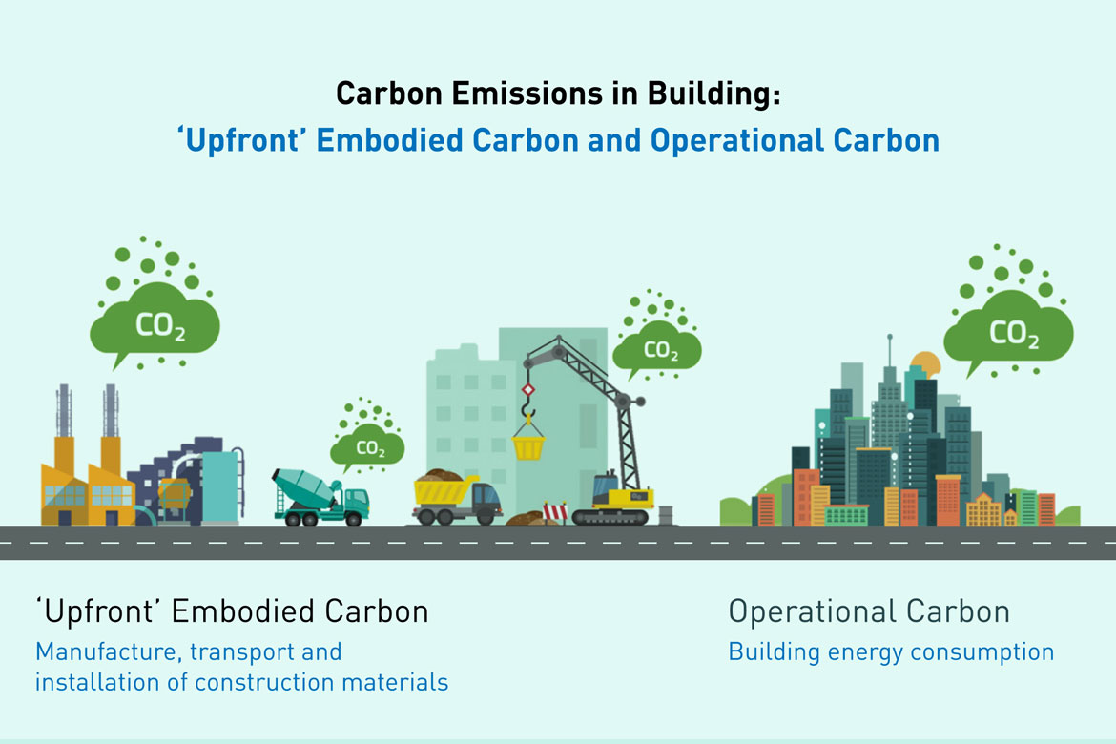
Co2 Emissions
Producing energy releases Co2
Most power plants burn fossil fuels to produce energy
Burning fossil fuels creates Co2
Additional operational costs create Co2

Slide 14

Solutions / Mitigation
Reduce demand
Take action

Slide 15


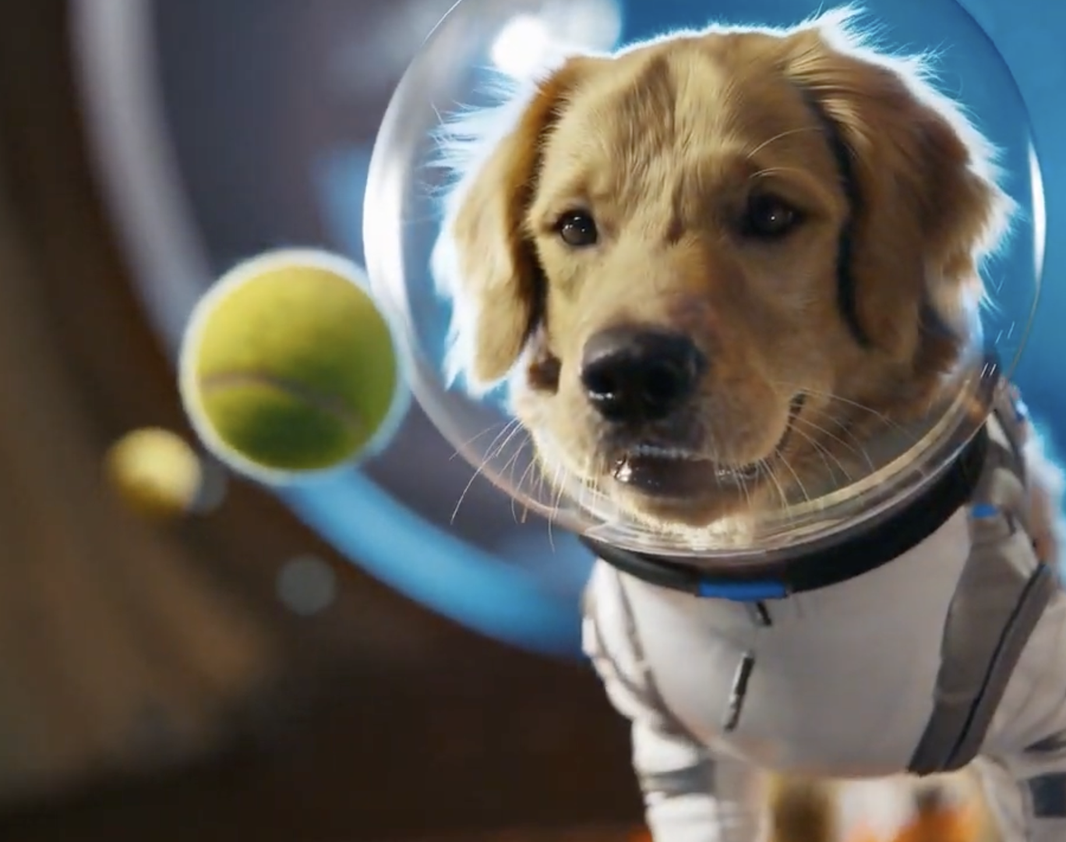

Solutions / Mitigation
Reducing Demand
Limit use of video models like Veo and Sora only to what is necessary
Find and re-use old search prompts for answers instead of re-prompting the model
Use models locally whenever possible

Slide 16
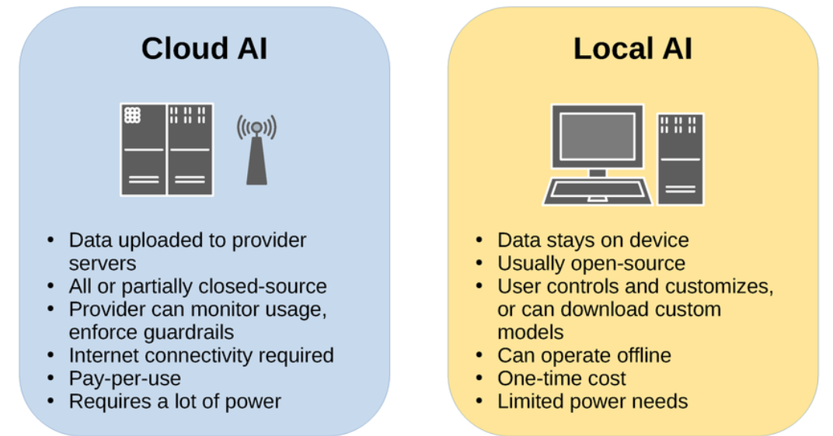
Solutions / Mitigation
Reducing Demand

Slide 17



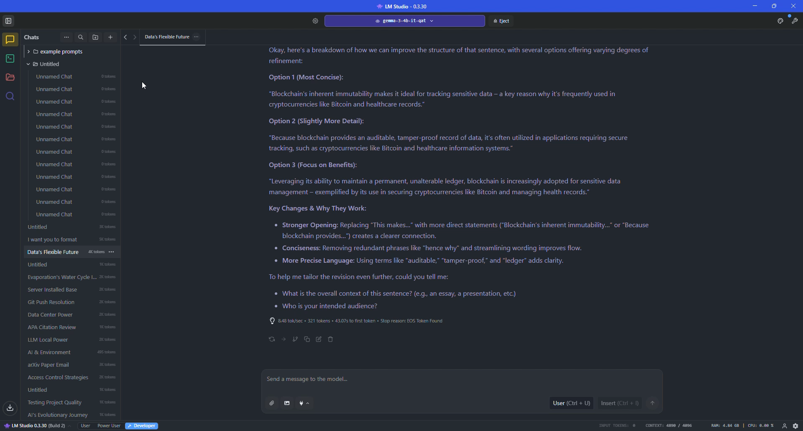

Reducing Demand
z
Using Local AI Models

Slide 18
Objectives
Insert

Slide 19
Course Skills Used:
Evaluate the advantages and drawbacks of selected trends.
Analyze the viability and impact of emerging technologies on the existing information systems and/or infrastructure.
Identify future opportunities for information technology solutions.
Conducting thorough research, source verification, and APA formatting.

Slide 20

Personal Links:
Link to resource center (contains additional research, tutorials, and more): https://github.com/FelipeRestrepo101/ResponsibleAI

Slide 21
Future Work:
Addin to the repository

Slide 22
References (to be formatted in APA)
https://eta-publications.lbl.gov/sites/default/files/2024-12/lbnl-2024-united-states-data-center-energy-usage-report_1.pdf
https://www.congress.gov/crs-product/R48646
https://www.eesi.org/articles/view/data-centers-and-water-consumption
https://cloud.google.com/blog/products/infrastructure/measuring-the-environmental-impact-of-ai-inference/
https://googleblog.blogspot.com/2009/01/powering-google-search.html
https://doi.org/10.48550/arXiv.2407.16894
https://doi.org/10.48550/arXiv.2509.19222
https://www.epri.com/research/products/3002028905

Slide 23
References (to be formatted in APA)
https://www.latimes.com/environment/story/2024-08-12/california-data-centers-could-derail-clean-energy-goals
https://time.com/7308925/elon-musk-memphis-ai-data-center/

